Slide 1
Engineering Exploration – Introduction to AR/VR
(23EE003)
Presentation
on
COMPONENTS OF JET TURBINE
Name of Student1 Id : ADITYA PRAKASH (2211981025)
Name of Student2 Id : ADITYA MISHRA (2211981024)
Name of Student3 Id : ADITYA CHAUDHARY (2211981020)
Name of Student4 Id : KHUSHDEEP (2211981199)
Under the supervision
of
Dr. Karthick
Chitkara University School of Engineering and Technology,
Chitkara University, Himachal Pradesh

Slide 2
Idea/Approach Details
Describe your idea/Solution/Prototype here:
We cannot afford a Jet Turbine for teaching mechanical engineering students the components of it. So we created an AR app that will show the components of a Jet Turbine and its description.

Slide 3
Technology Used
Describe your Technology Stack here:
Softwares Used => Unity 3D, Visual Studio Code

Slide 4
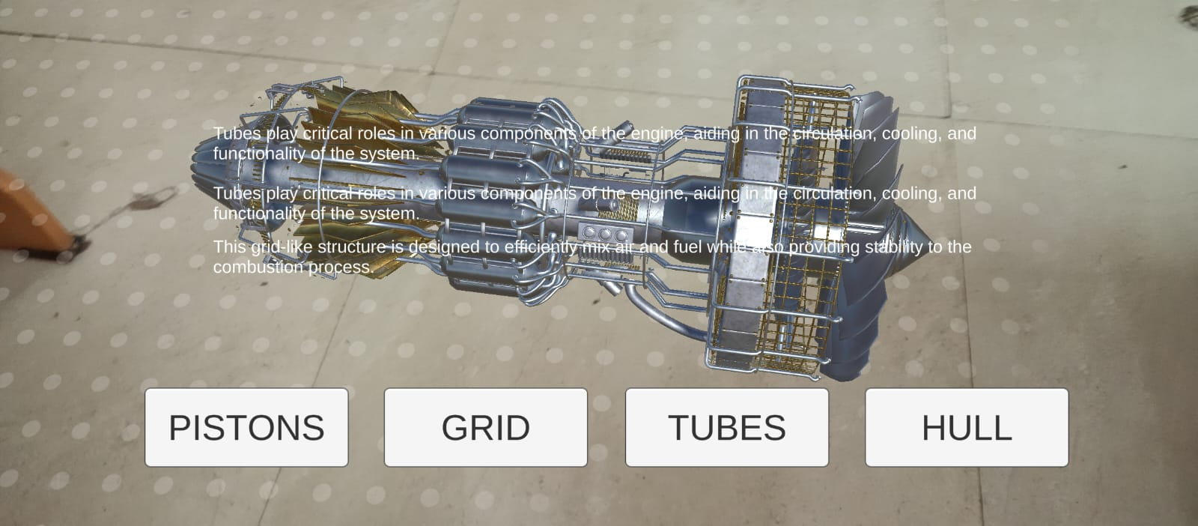
Flow Chart
Buttons should be clicked for toggling different components.

Slide 5
Applications of the Project
AR apps can be used in educational settings to teach students or professionals about the various components of a jet turbine. Users can explore and interact with 3D models of turbine parts, learning about their functions, assembly, and maintenance.
Engineers can use AR apps to visualize and test new designs or modifications to jet turbine parts.
Companies in the aerospace industry might use AR apps as sales tools.

Slide 6
Questions???
Any Queries?

Slide 7
THANK YOU

